Slide 1
Machine Learning Class Fall 2025 Assignment 2
Instructor: Prof. Chun-Yi Lee (李濬屹)
TA Email: ml-elsalab@googlegroups.com

Slide 2
Rule
Deadline: 2025-10-31 23:59
You have a total of two extra days available for late submissions across all assignments
If you want to use late days for an assignment, please send an email to ml-elsalab@googlegroups.com specifying the number of late days you intend to use (in units of days)
If you have any questions related to the assignment
encourage you to post them in the discussion section on NTU Cool

Slide 3
Overview
Q1-Q4: Colab (70%)
Q1: Clustering (15%)
Q2: Dimensionality Reduction (20%)
Q3: Convolutional Neural Networks (CNNs) (20%)
Q4: Recurrent Neural Networks (RNNs) (15%)
Q5: Kaggle Competition (30%+ Bonus: 20%)
Who play this game?

Slide 4
Q1-Q4: Colab (70%)
Fill in all `# TODO` blocks. Answer bolded questions in this notebook.
Q1: Clustering (15%)
Q2: Dimensionality Reduction (20%)
Q3: Convolutional Neural Networks (CNNs) (20%)
Q4: Recurrent Neural Networks (RNNs) (15%)

Slide 5
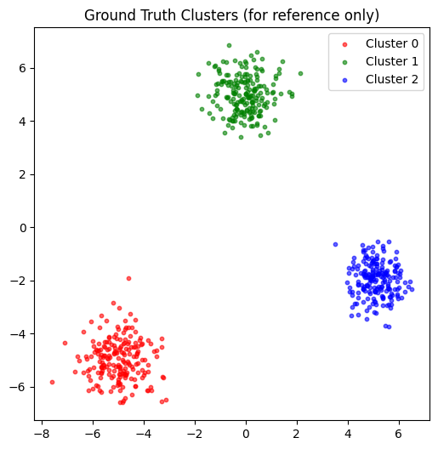
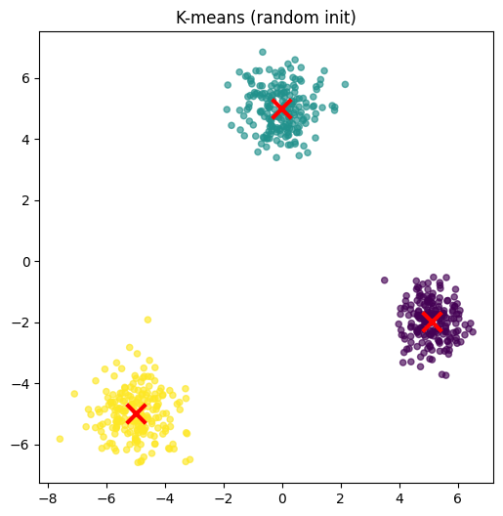
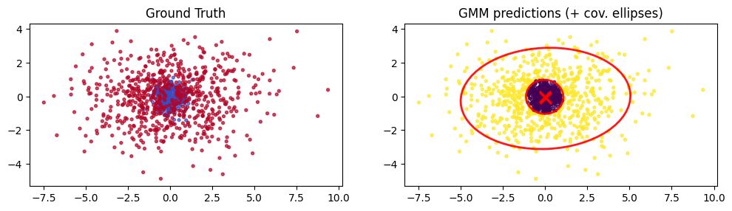
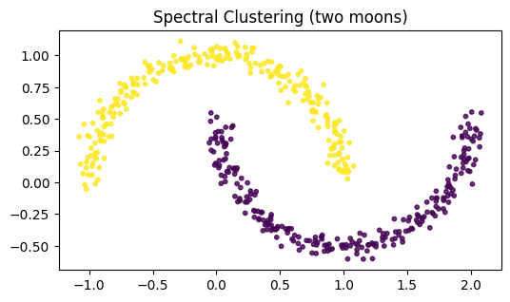
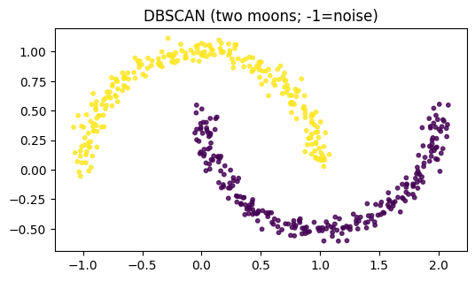
Q1
Part A: K-means
Part B: Gaussian Mixture Model (GMM)
Part C: Non-convex clustering

Slide 6
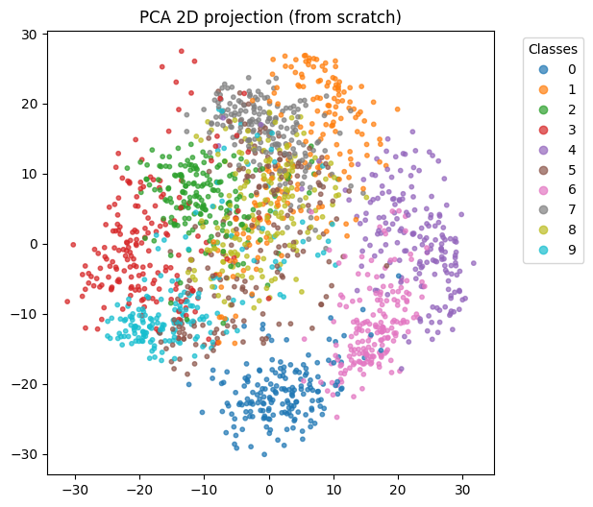
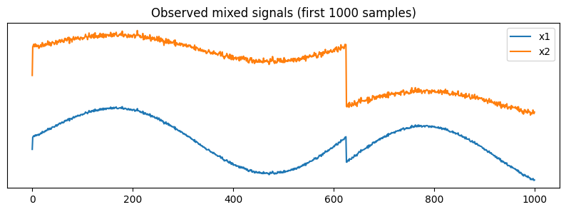
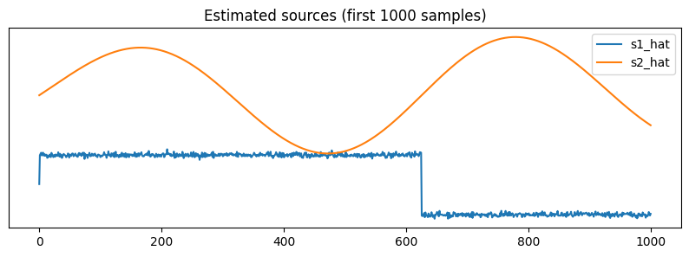
Q2
Part A: Principal Component Analysis
Part B: Independent Component Analysis (ICA)
Part C: Downstream application on MNIST (Pseudo-label pipeline)

Slide 7
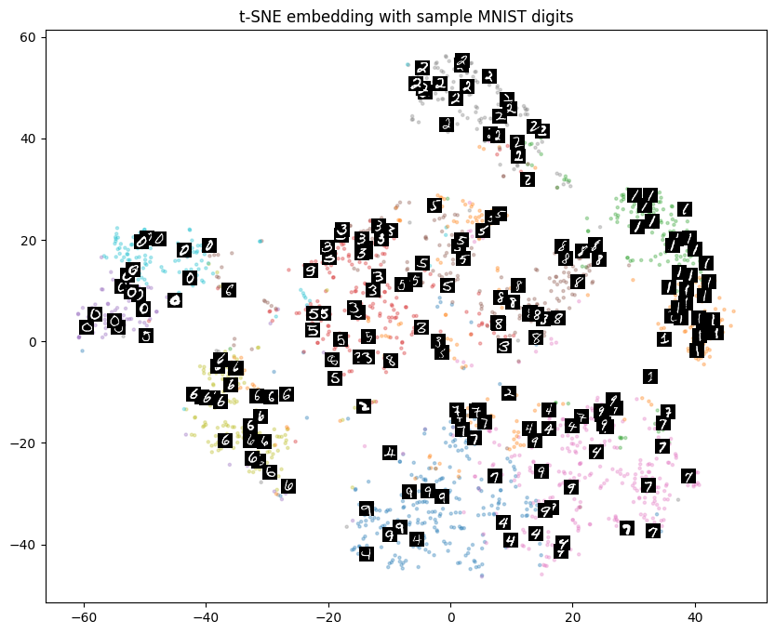
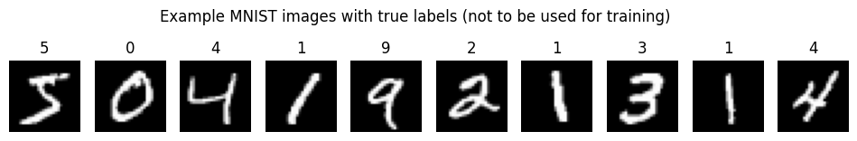
Q2
Part C: Downstream application on MNIST (Pseudo-label pipeline)
Required: Pseudo-label logistic regression accuracy ≥ 0.95 on the test set

Slide 8
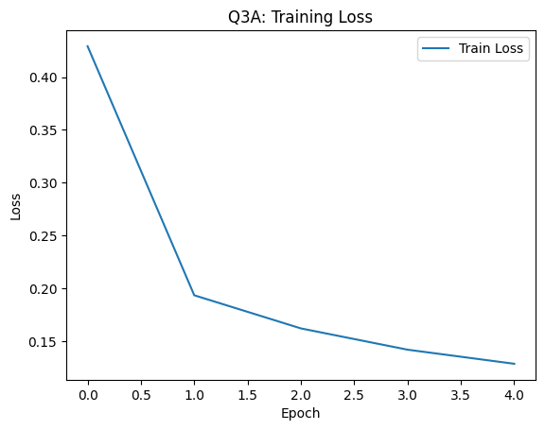
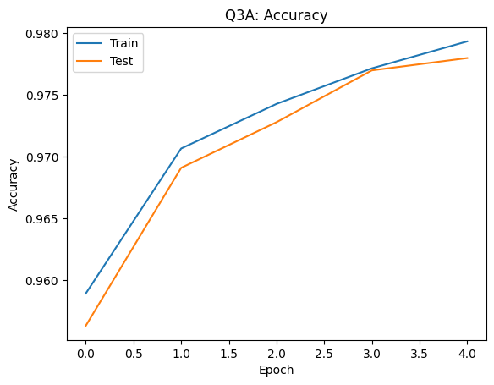
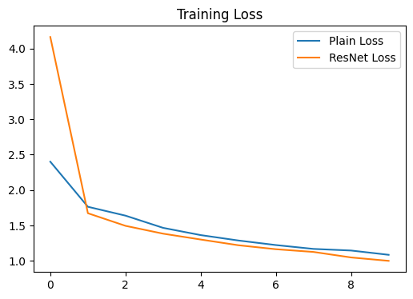
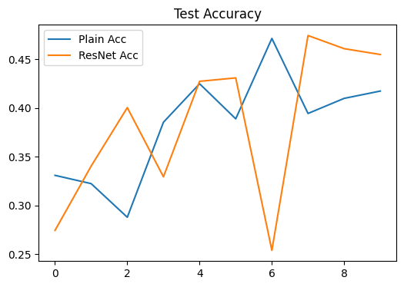
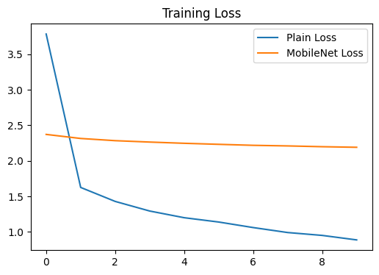
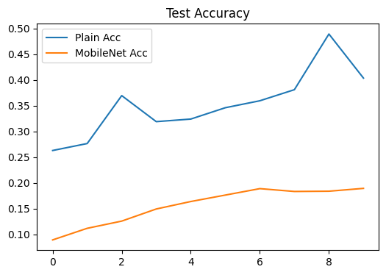
Q3
Part A: Build & Train CNN on MNIST
Part B: ResNet Block on CIFAR-10
Part C: Depthwise Convolution (MobileNet-lite)

Slide 9
Q4
Part A: Recurrent Neural Networks (RNNs)
Part B: LSTM
Part C: GRU

Slide 10
Q5: Kaggle Competition (30%+ Bonus: 20%)
Please use your student ID as the team name.
Submissions that do not follow the team naming rule will be considered invalid and treated as not submitted.
If you are an auditor, add _a after your student ID (e.g., b12345678_a).
Each team may submit up to 10 times per day.
Who play this game?

Slide 11
Q5
https://www.kaggle.com/t/3561ff53a80d466c9f929e473600abcb
Who play this game?
Based on the given games, output the predicted player ID (1–600) for each testing file.

Slide 12
Training set
The training set consists of 200 files (1.sgf, 2.sgf, …, 200.sgf), each corresponding to a single player.
Each file contains approximately 2,000 games played by that player.
All game records within the same file are guaranteed to come from the same individual, ensuring consistent player identity labels.

Slide 13
Testing Set
The test data is divided into two subsets: query and candidate.
Each subset contains 600 files (1.sgf, 2.sgf, …, 600.sgf).
Each file represents a single player, containing approximately 100 games from that player.
The query and candidate sets generally contain different players — the file IDs do not correspond to the same individuals.

Slide 14
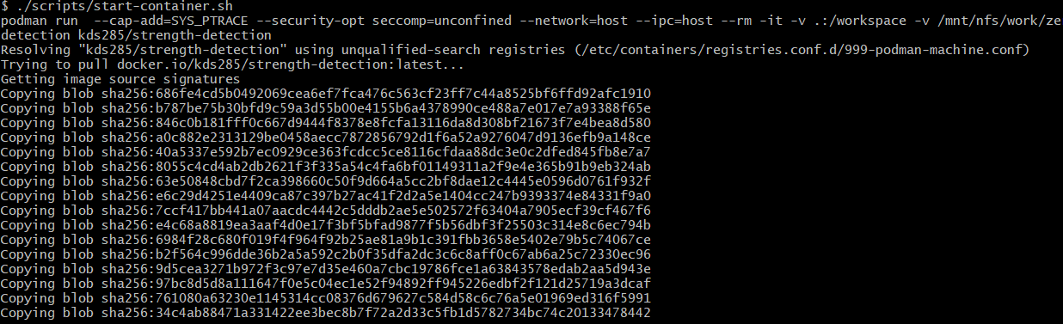
Environment
git clone --recursive https://github.com/gcobs104628/ML-Assignment2-Q5.git
./scripts/start-container.sh (Run the container using Podman)
Linux: sudo apt-get install -y podman
Windows: you can use WSL to run podman

Slide 15
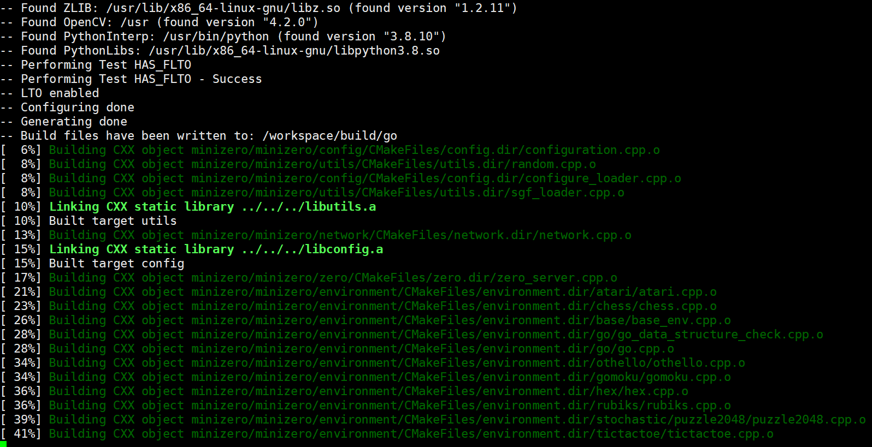
Environment
In the container
./scripts/build.sh go

Slide 16
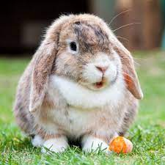

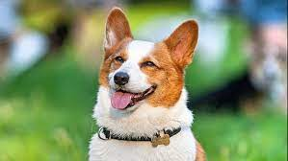
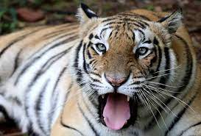
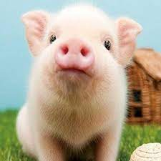
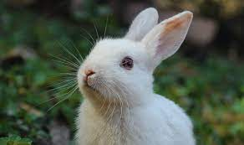
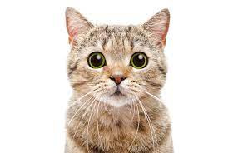
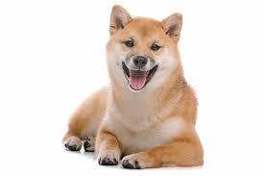
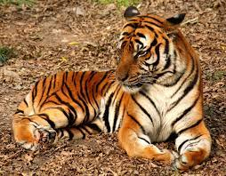
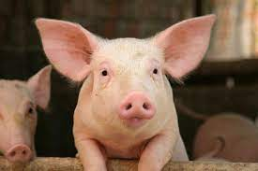
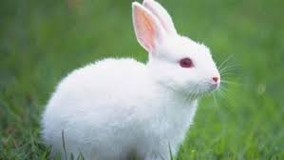
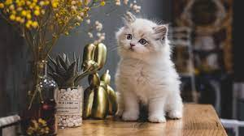

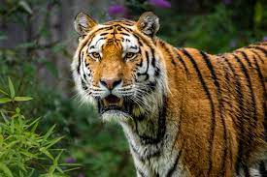
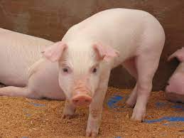
Methods you may use: Few-Shot Learning
Few-Shot Learning is a sub-area of machine learning
Classifying new data when you have only a few training samples
Animal
We only have
…
…
…
…
…
How to classify other animal?
Notes:
句點

Slide 17
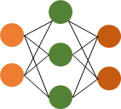
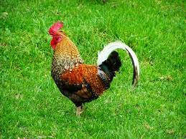
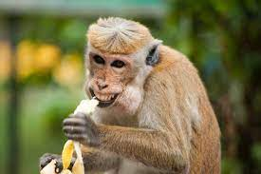
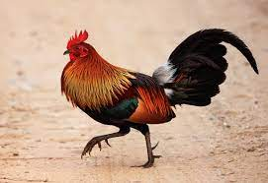
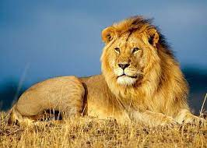
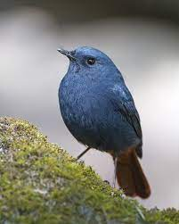
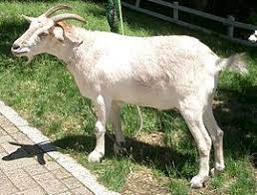
Few-Shot Learning
Learn the general idea from few training samples
Learn a similarity function
Training Set
Query Sample
Chicken
…
…
…
…
…
sim = 0.2
sim = 0.9
sim = 0.3
sim = 0.7
sim = 0.1
Candidate Set

Slide 18
Recommended Network Architecture
Residual
CNN
Blocks
MLP
RNN/LSTM/
transformer
1st Move
Residual
CNN
Blocks
MLP
2nd Move
MLP+Tanh
Normalize
Game
Vector
…...
Residual
CNN
Blocks
MLP
N-th Move

Slide 19
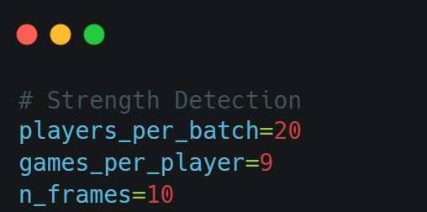
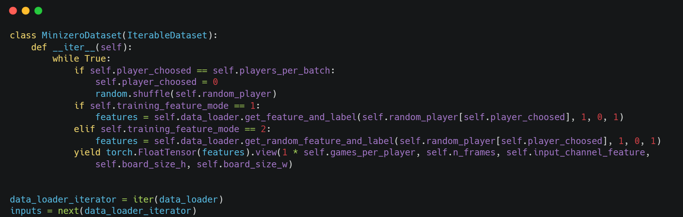
Dataloader Sample
When you call inputs = next(data_loader_iterator)
the dataloader returns
style_py.get_players_per_batch() * style_py.get_games_per_player() games.
From each game, style_py.get_n_frames() board positions (frames) are sampled.
All of these parameters can be configured in conf.cfg

Slide 20
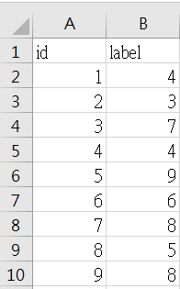
Submit
You must submit your prediction results (e.g., submission.csv) to Kaggle
Refer to the submission_sample.csv provided on the website to check the required upload format

Slide 21
Reference
The following papers may help you design Network Architecture & loss function
"Deep clustering for unsupervised learning of visual features." ECCV 2018.
"Generalized end-to-end loss for speaker verification." ICASSP 2018.
"Detecting individual decision-making style: Exploring behavioral stylometry in chess." Neurips 2021

Slide 22
🎮 Enjoy the assignment! 😃

